Slide 1
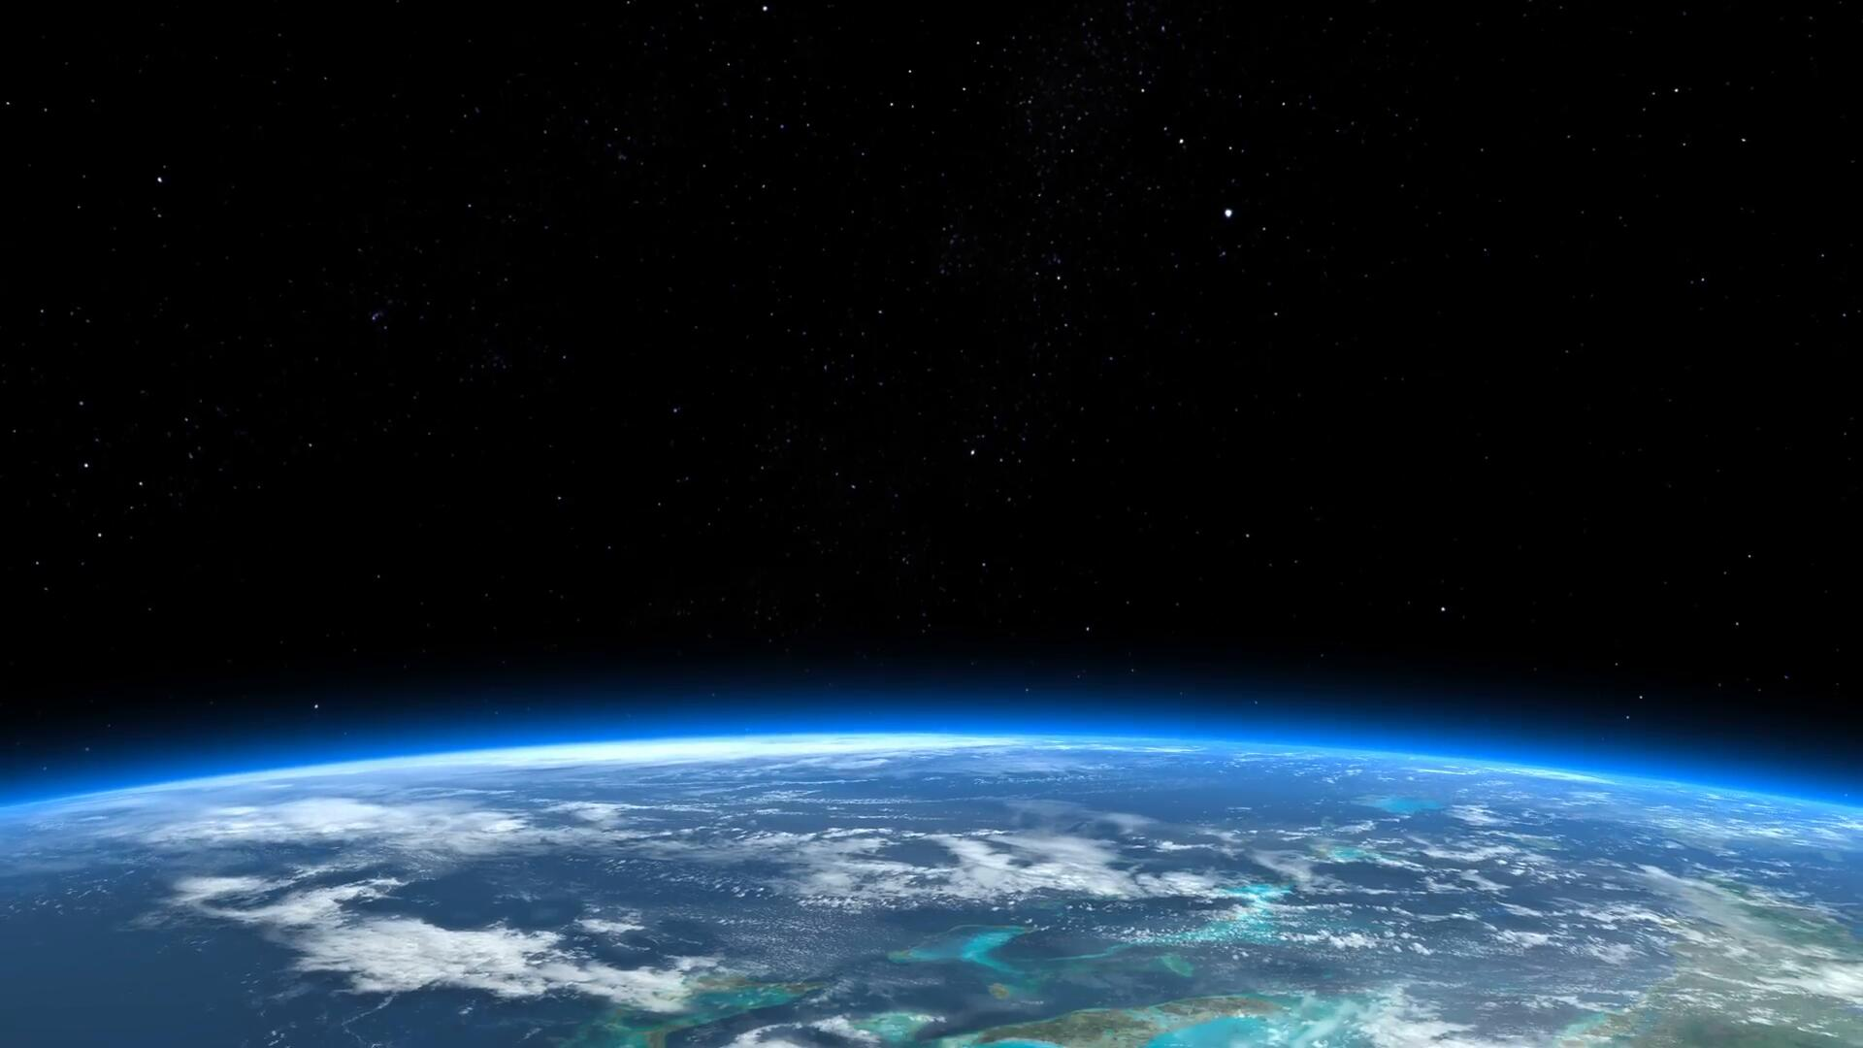

Press Briefing: Spaceship Titanic Collision Update
ML Final Project by: Alonso Romero
https://insights.som.yale.edu/insights/is-there-profit-in-outer-space

Slide 2

Introduction
The Spaceship Titanic was an interstellar passenger liner launched a month ago. With almost 13,000 passengers on board, the vessel set out on its maiden voyage transporting emigrants from our solar system to three newly habitable exoplanets orbiting nearby stars.
https://www.spaceforce.mil

Slide 3
The Collision
While rounding Alpha Centauri en route to its first destination—the torrid 55 Cancri E—the unwary Spaceship Titanic collided with a spacetime anomaly hidden within a dust cloud. Sadly, it met a similar fate as its namesake from 1000 years before. Though the ship stayed intact, almost half of the passengers were transported to an alternate dimension!
https://www.spaceforce.mil

Slide 4
Situation
When the collision occurred, the ship’s computer system was damaged and lost about 4,300 records of passenger data.
Our goal is to find the transported status of these passengers.
https://www.spaceforce.mil

Slide 5
Motivation to solve problem
Rescue loved ones that are lost in space
Give peace of mind to families
Allow the Spaceship Titanic to continue future voyages across space
https://www.spaceforce.mil

Slide 6
Solution to Problem
Implement machine learning models
Training Dataset (Train.csv)
Personal records for about 8,700 passengers
This dataset was recovered from the ship’s damaged computer system
Test Dataset (Test.csv)
Personal records for about 4,300 passengers
This dataset will be used to predict the value of transported passengers that we are seeking to address the situation
https://www.spaceforce.mil

Slide 7
What factors are considered for prediction?
HomePlanet
CryoSleep
Cabin
Destination
Age
VIP
Luxury Amenities Spent
RoomService, FoodCourt, ShoppingMall, Spa, VRDeck
https://www.spaceforce.mil

Slide 8
How are we making our prediction?
Logistic Regression
Decision Tree Classifier
Random Forest Classifier
Gradient Boosting Classifier
XGBoost Classifier
K-Nearest Neighbors
https://www.spaceforce.mil

Slide 9
Model Results
 | Initial Accuracy | Initial AUC-ROC Score | Cross-Validation AUC-ROC (5 folds) | Tuned AUC-ROC Score
Logistic Regression | 77% | 86% | 87.36% | 86.50%
Decision Tree | 76% | 76% | 74.18%
Random Forest | 79% | 87% | 88.04% | 88.55%
Gradient Boosting | 79% | 89% | 89.32% | 89.34%
XGBoost | 78% | 88% | 88.39% | 88.01%
K-Nearest Neighbors | 71% | 77% | 73.78%
https://www.spaceforce.mil

Slide 10
Model Selection
Gradient Boosting Classifier
https://www.spaceforce.mil

Slide 11
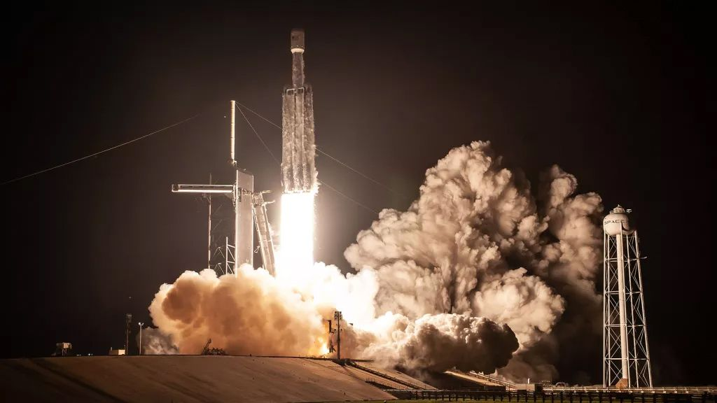
Conclusion
Of 4277 passengers on board:
2263 Passengers were transported
2014 Passengers were not transported
https://www.livescience.com/34475-how-do-space-rockets-work-without-air.html

Slide 12
References
Claybaugh, B. (2011). Is there profit in outer space? Yale Insights. Retrieved December 4, 2024, from https://insights.som.yale.edu/insights/is-there-profit-in-outer-space
Howard, A., Chow, A., & Holbrook, R. (2022). Spaceship Titanic. Kaggle. Retrieved October 1, 2024, from https://www.kaggle.com/competitions/spaceship-titanic
Howell, E. (2022). How do space rockets work without air? Live Science. Retrieved December 4, 2024, from https://www.livescience.com/34475-how-do-space-rockets-work-without-air.html
Hyperparameter tuning. (2023). GeeksforGeeks. Retrieved November 29, 2024, from https://www.geeksforgeeks.org/hyperparameter-tuning/
Singh, Y. (2022). K-Fold Cross Validation Using Python and Scikit-Learn. Proclus Academy. Retrieved November 29, 2024, from https://proclusacademy.com/blog/practical/k-fold-cross-validation-sklearn
United States Space Force. (N.d.). United States Space Force. Retrieved December 4, 2024, from https://www.spaceforce.mil
XGBoost Parameters. (2022). DMLC XGBoost. Retrieved November 29, 2024, from https://xgboost.readthedocs.io/en/stable/parameter.html
https://www.spaceforce.mil

